Slide 1
Chapter 4
Inequality

Slide 2
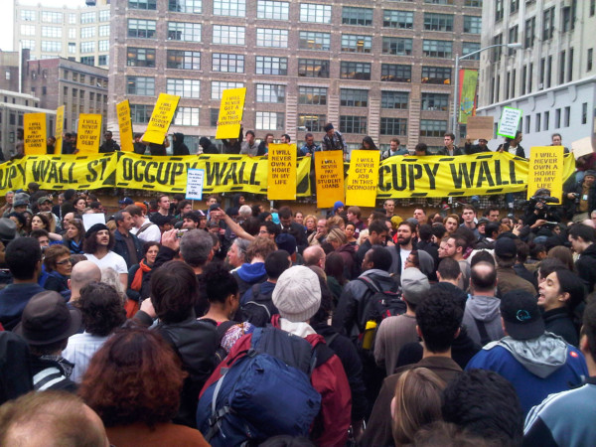
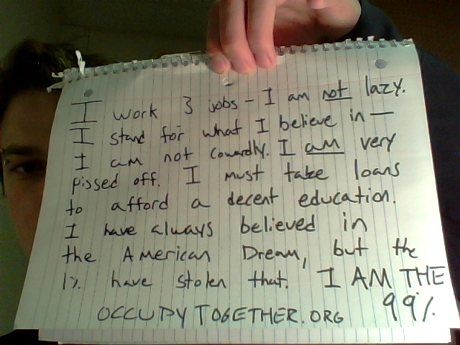
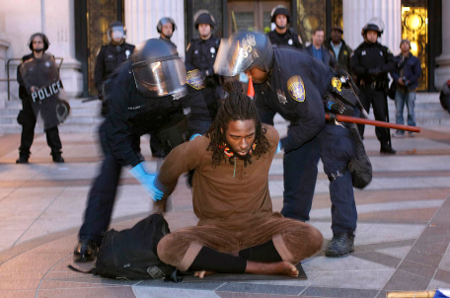


Why Does It Matter?

Slide 3
We Are the 99 Percent
We are the 99 percent. We are getting kicked out of our homes. We are forced to choose between groceries and rent. We are denied quality medical care. We are suffering from environmental pollution. We are working long hours for little pay and no rights, if we're working at all. We are getting nothing while the other 1 percent is getting everything. We are the 99 percent.

Slide 4
Inequality Does Not Imply Poverty (Necessarily), but People Care About It
Social Justice
Relative Deprivation: Disutility from not having consumption possibilities others have in reference group
Human development (HD) hard to achieve in POOR countries if income concentrated at top
Inequitable growth and HD outcomes:
  If distribution unchanged (and at least some benefits reach the poor), income growth should reduce poverty
  Improving HD outcomes without growth is likely to require altering the income distribution
Distribution of income shapes structure of production (in relatively closed or large economies, at least)

Slide 5
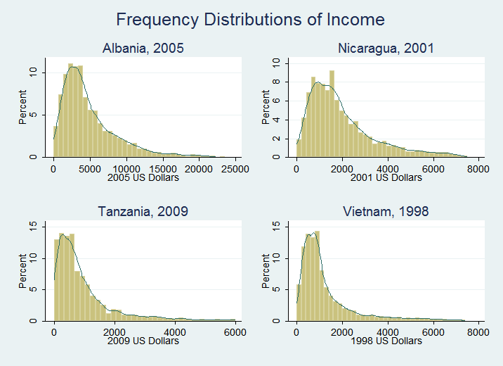
How to Measure Inequality
Frequency Distributions:
Aren’t so easy to compare…

Slide 6
Traditional Statistical Measures
Variance
Coefficient of Variation
Problem: These are not indexes

Slide 7
What Properties Do We Want Our Index to Have?
The Piguo-Dalton principle
  Inequalityincreases when income is transferred from a low-income household to a high-income household
Symmetry
  Does not change when individuals trade positions in the income distribution
Independence of income scale
  A proportional change in all incomes does not alter inequality
Homogeneity
  A change in the size of the population will not affect measured inequality
Decomposability with respect to income sources
  To explore influences of specific income sources on inequality
Several fit, but for only one can you draw a picture like this one:

Slide 8
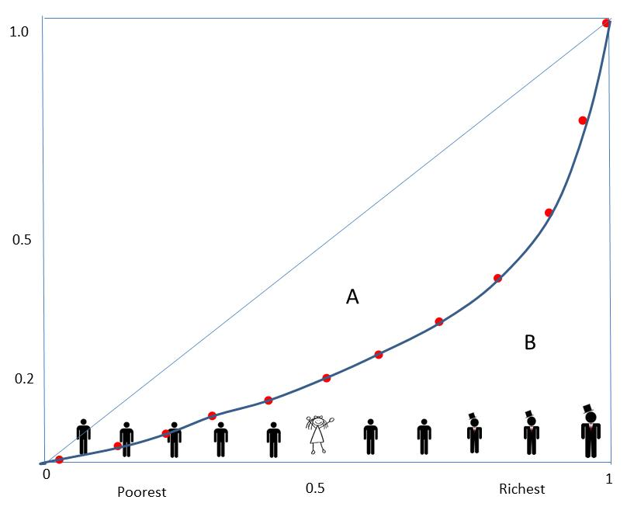
The Lorenz Curve: A Better Idea
Cumulative % of income
Gini = A/(A+B)
Min: 0 (Perfect equity)
Max: 1 (Perfect inequality)
Cumulative % of population

Slide 9
How to Calculate the Gini Efficiently with Micro Data
  Line everyone up from poorest to richest
  Y_{n} is person n’s income
  F(Y_{n}) is the share of people with income at or less than Y_{n}
  μ is mean income
  => G=2*Cov(Y_{n},F(Y_{n}))/μ

Slide 10
Inequality in Practice

Slide 11
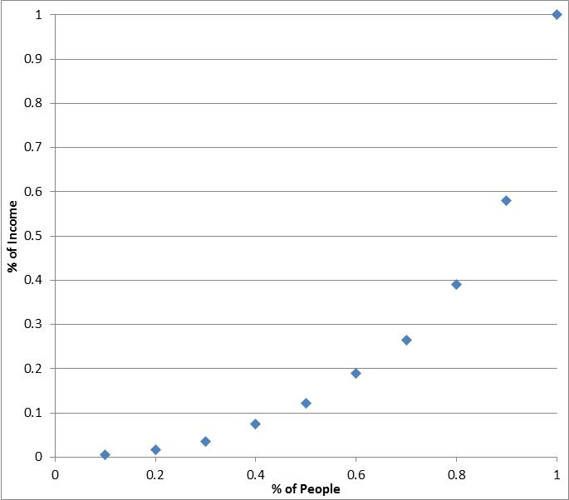
We Live in an Unequal World
N. America has about 1/20 of the world’s population but 1/4 of its GDP (PPP) in
Almost half the world — over three billion people — live on less than $2.50 a day
The world Gini coefficient is somewhere between .6 and .8
…which looks something like this:
A
B
G=A/(A+B), 0≤G ≤1

Slide 12
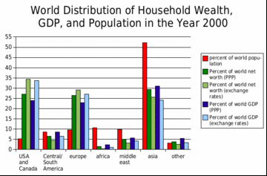
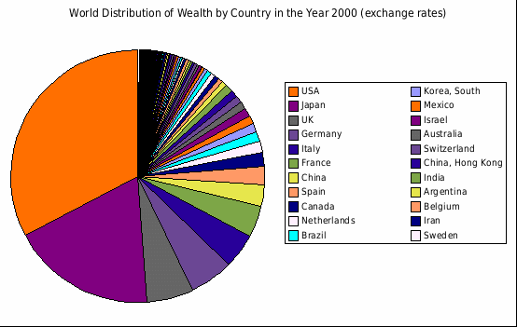
We Are a Big Part of the Story of World Income Inequality
Where the Occupy Movement Began

Slide 13
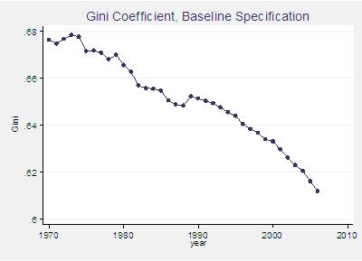

But There’s Evidence World Income Inequality Has Been Falling
(at least until recently)
?
Xavier Sala-i-Martin
Professor of Economics, Columbia University
Pinkovskiy, Maxim and Xavier Sala-i-Martin (2009), “Parametric Estimations of the World Distribution of Income”, NBER Working Paper 15433.

Slide 14
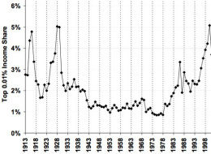
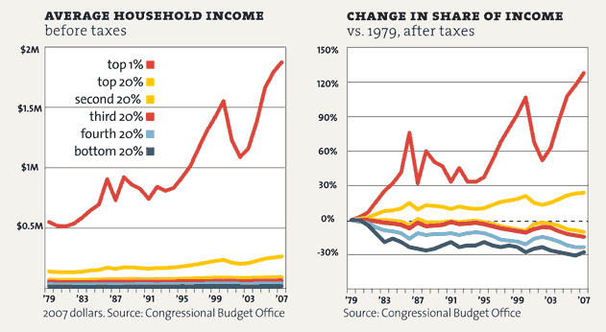
The US is Less Unequal than the World
…but the dynamics favor growing inequality
  Especially at the very top

Slide 15
What Explains this Inequality?
  Start with our formula for the Gini:
  G=2*Cov(Y_{n},F(Y_{n}))/μ
  Where:
  Y_{n} is person n’s income
  F(Y_{n}) is the share of people with income at or less than Y_{n}

Slide 16
Decompose It By Income Source
  If people can get income from K different sources:
  Y_{n} is the sum of Y_{nk} , k=1,…,K
  Then (because of a summation property of covariances)
S_{k} is the share of income in the economy from source k (e.g., profits or wages)
G_{k} (0≤G_{k}≤1, the “income-source Gini”) is the Gini describing how income from this source is distributed
R_{k} (-1≤R_{k}≤1, the “Gini correlation”) tells us where in the income distribution this source of income goes (its correlation with people’s income ranking)

Slide 17
Let’s Take an Example: The Earned Income Tax Credit (EITC)
Largest poverty reduction program in the United States
  Almost 21 million families in 2004
  Total cost: $36 billion in 2004
  Lifted 5.4 million above the poverty line in 2010 (US Census Bureau)
The US GDP was $11.7 trillion in 2004
  S_{eitc} was small
The EITC was not very equally distributed
  Most people did not get it
  The G was fairly high
BUT the R was low
  The EITC went to people at the lower end of the income distribution
Because it’s S is small, the EITC couldn’t lower inequality very much.
*In the U.S., the major anti-poverty program is in our tax code: the earned income tax credit. Beware the tax code reformers!

Slide 18
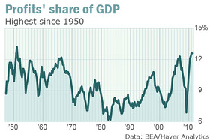
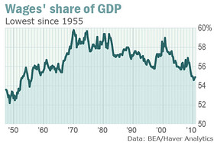
Another Example: Profits
Source: Marketwatch http://www.marketwatch.com/story/corporate-profits-share-of-pie-most-in-60-years-2011-07-29

Slide 19
What Does Our Gini Decomposition Say?
The profit S is high
The profit G is high: profits are unequally distributed
  Though less unequal than many people think, because those mega-companies are in our pension plans!
The profit R is also high: profits flow disproportionately into households at the top of the income distribution
Profits are increasing (just listen to quarterly earnings reports from Chevron, Microsoft, Citicorp, etc.)
Employment and wages are not increasing much
This is the biggest reason why our Gini is rising

Slide 20
Another Reason: You
The k=“wages” has a lot of different income flows in it
  High versus low skilled workers
  The high-skilled share of wages is increasing rapidly
  Wages for low-skilled workers have been falling
The S for wages is large and rising
The G is high (wages are unequally distributed)
The R is also high (high-skilled wages go to upper-middle and top of the income distribution)
…especially when you include bonuses
So high-skilled wages are increasing G!
Obama wants to lower G with minimum wages
  What does that do?

Slide 21
Development Projects and Inequality
The benefits of a project must be unequally distributed to reduce inequality
  This is an implication of our formula, since the share of an income source k in the Gini is S_{k}G_{k}R_{k}, so G_{k}=0 means no effect on inequality!
  But they have to favor the bottom or middle of the income distribution (R_{k} small or negative)

Slide 22
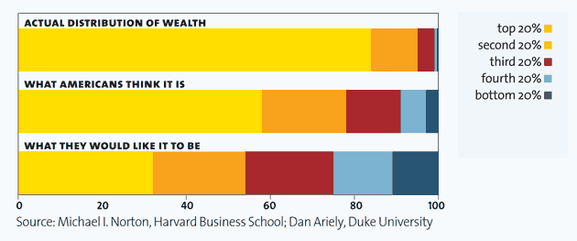
The Information Void:
Americans want it more equal, but they don’t know it
(and perceptions matter!)

